Slide 1
General License Course Chapter 4.1 - Electrical Review

Slide 2
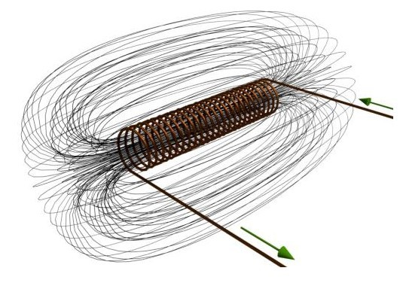
Show and Tell:Toys...
Demos: Inductor, electromagnet/compass, transformer

Slide 3
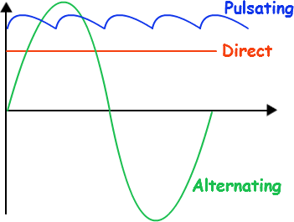
Direct vs. Alternating Current
Alternating current (AC) - the flow of electric current periodically reverses direction (alternates)
Direct current (DC) - the flow of electric current is only in one direction
One AC cycle is shown below, in green. 60 Hz (cycles per second) is the frequency of AC power transmission in the U.S.
Vertical axis = voltage
Horizontal axis = time

Slide 4
Current, Voltage, and Power
Current = I, the flow of electrons, measured in Amperes (A or Amps) with an ammeter
Voltage = E, electro-motive force that makes electrons move, measured in volts (V) with a voltmeter
Power (P) is measured in watts (W) with a wattmeter, P = E x I

Slide 5
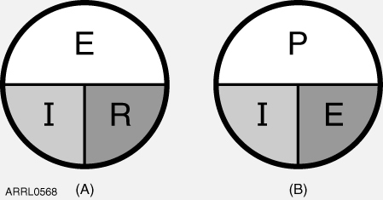
Resistance & Ohms Law
Resistance (R) is the opposition to current flow measured in Ohms (Ω) with an ohmmeter.
R=E/I, I=E/R, E=I x R, P=I x E, P=I² x R, P=E² / R
Pay attention to UNITS of measurement!

Slide 6
Doing the Math
How many watts of electrical power are used if 400 V dc is supplied to an 800 ohm resistor (load)?
P=E²/R
P= (400 x 400) / 800 = 160,000 / 800
160,000 / 800 = 200 watts

Slide 7
Doing the Math
How many watts of electrical power are used by a 12V dc light bulb that draws 0.2 A?
P = E x I
P = 12V x 0.2A = 2.4 watts

Slide 8
Doing the Math
How many watts are being dissipated when a current of 7.0 mA flows through a 1250 ohm resistance?
P = I² x R (I in Amps, R in OHMS!)
P = (.007 x .007) X 1250 = 0.06125 W
0.06125 W = ~61 mW (milliwatts)

Slide 9
The decibel (dB)
The decibel (dB) is a logarithmic unit used to express the ratio of two values of a physical quantity. One of these values is a standard reference value, in which case the decibel is used to express the level of the other value relative to this reference.
The following examples yield unitless answers in dB because they are relative ratios expressed in decibels

Slide 10
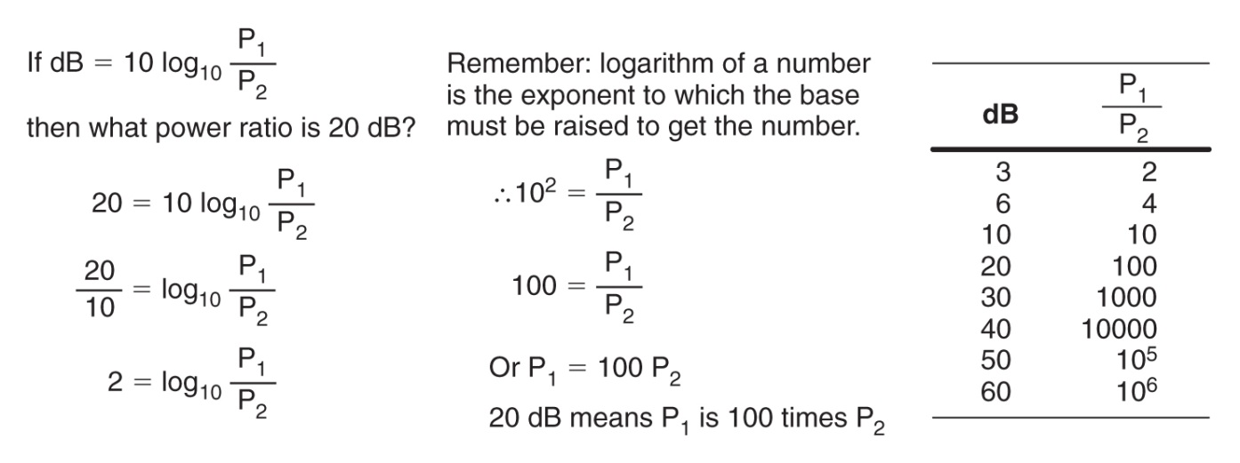
dBs to Remember
AND a 1 dB loss represents a 20.6% reduction of power.
(a 1dB gain would be a 25.8% increase – see handout)

Slide 11
Doing the Math - Decibels
What percentage of power loss would result from a transmission line loss of 1 dB?
First, calculate how much power is reaching the antenna:
Percentage Power = 100% x log⁻¹ (dB/10)
100% x log⁻¹ (-1/10) = 100% x log⁻¹ (.1) = ~79.4%
Therefore, a 1 dB loss represents a 20.6% loss of power (in the form of heat)

Slide 12
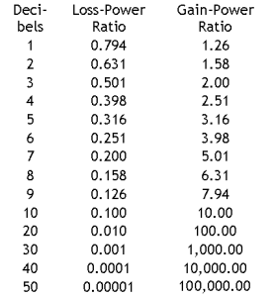
3 dB Rule
Remember that to double power or reduce power by half is a 3 dB change
A 2 times increase in power is ___ dB?
dB = 10 log₁₀ (P_{M} / P_{Ref})
dB = 10 log₁₀ (2 / 1) = 3dB
Keystrokes: 2 / 1 = 2 [log] x 10 = 3.010299
(round answer to 3 dB)

Slide 13
Take Quiz 1

Slide 14
G5B01 - What dB change represents a factor of two increase or decrease in power?
A. Approximately 2 dB
B. Approximately 3 dB
C. Approximately 6 dB
D. Approximately 9 dB

Slide 15
G5B01 - What dB change represents a factor of two increase or decrease in power?
A. Approximately 2 dB
B. Approximately 3 dB
C. Approximately 6 dB
D. Approximately 9 dB

Slide 16
G5B03 - How many watts of electrical power are consumed if 400 VDC is supplied to an 800-ohm load?
A. 0.5 watts
B. 200 watts
C. 400 watts
D. 3200 watts

Slide 17
G5B03 - How many watts of electrical power are consumed if 400 VDC is supplied to an 800-ohm load?
A. 0.5 watts
B. 200 watts
C. 400 watts
D. 3200 watts

Slide 18
G5B04 - How many watts of electrical power are consumed by a 12 VDC light bulb that draws 0.2 amperes?
A. 2.4 watts
B. 24 watts
C. 6 watts
D. 60 watts

Slide 19
G5B04 - How many watts of electrical power are consumed by a 12 VDC light bulb that draws 0.2 amperes?
A. 2.4 watts
B. 24 watts
C. 6 watts
D. 60 watts

Slide 20
G5B05 - How many watts are consumed when a current of 7.0 milliamperes flows through a 1,250-ohm resistance?
A. Approximately 61 milliwatts
B. Approximately 61 watts
C. Approximately 11 milliwatts
D. Approximately 11 watts

Slide 21
G5B05 - How many watts are consumed when a current of 7.0 milliamperes flows through a 1,250-ohm resistance?
A. Approximately 61 milliwatts
B. Approximately 61 watts
C. Approximately 11 milliwatts
D. Approximately 11 watts

Slide 22
G5B10 - What percentage of power loss is equivalent to a loss of 1 dB?
A. 10.9 percent
B. 12.2 percent
C. 20.6 percent
D. 25.9 percent

Slide 23
G5B10 - What percentage of power loss is equivalent to a loss of 1 dB?
A. 10.9 percent
B. 12.2 percent
C. 20.6 percent
D. 25.9 percent

Slide 24
General License Course Chapter 4.2 - AC Power

Slide 25
AC Power
Definition and Measurement
Root Mean Square (V_{RMS})
The RMS value for an ac voltage is equivalent to the value of a dc voltage that results in the same power dissipation in a resistor

Slide 26
Definition & Measurement
RMS value is 0.707 times the ac waveform peak voltage (V_{PK})
V_{RMS} = 0.707 x V_{PK} = 0.707 x (V_{P-P} / 2)
V_{PK} = 1.414 x V_{RMS}
V_{P-P} = 2 x 1.414 x V_{RMS} = 2.828 x V_{RMS}
(next slide....)

Slide 27
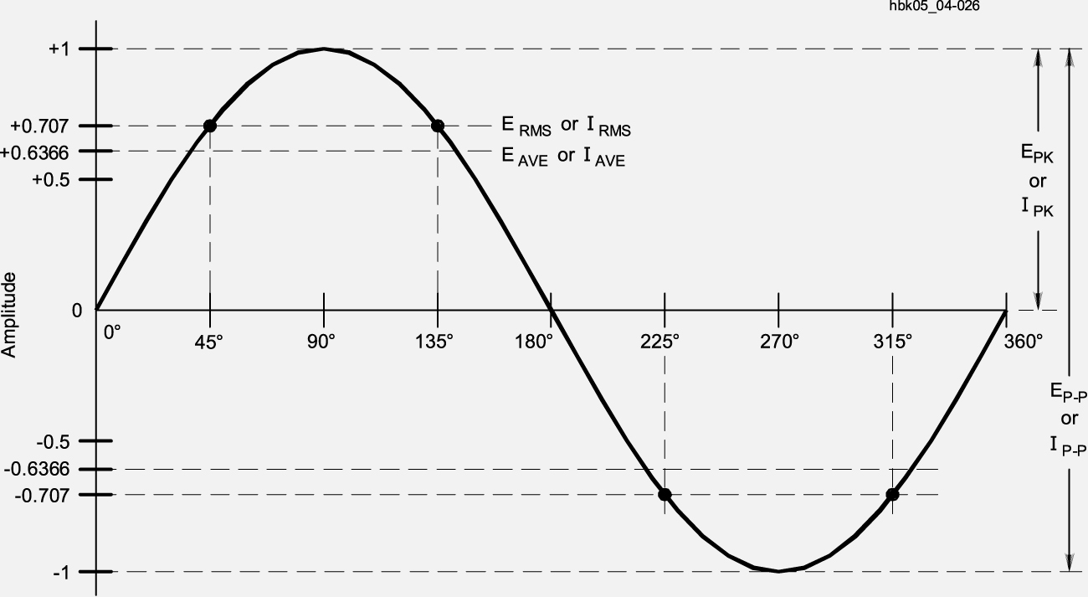
Measurements
Relationships between RMS, average, peak-to-peak (p-p) values
120v AC RMS =
~170v peak =
~340 p-p
Components must be able to withstand PEAK voltages!

Slide 28
Doing the RMS Math
A sine wave with a peak voltage of 17 V has an RMS value of?
V_{RMS} = 0.707 x 17 V = 12 V

Slide 29
PEP Definition & Measurement
PEP (Peak Envelope Power) is the average power of one complete RF cycle at the peak of the signal’s envelope
PEP is an easy way to measure or specify the maximum power of an amplitude modulated signal
1500 W PEP is the full amateur power limit

Slide 30
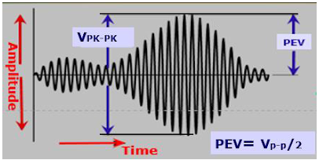
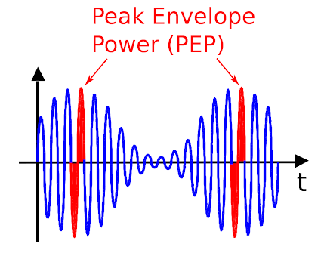
These are illustrations of modulated AM signals. (Unmodulated carriers will be discussed in a moment)
To determine PEP, measure the amplitude of the peak of the modulation envelope, in volts.
That is Peak Envelope Voltage (PEV) in the top figure.
From this, the RMS voltage and PEP can be calculated

Slide 31

PEP Doing the Math
E = √P x R
Keystrokes:
1200 x 50 = 60,000 [square root symbol] = 244.9489
Round answer to 245 V

Slide 32
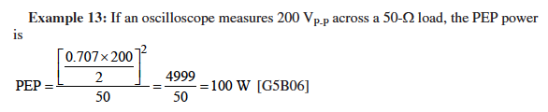
PEP Doing the Math
P = E²/R and PEV = Peak to Peak ÷ 2
- 0.707 x (200 ÷ 2) = 70.7 [x²] / 50 = 99.97
- Round answer to 100 W

Slide 33
PEP Doing the Math
What is the output PEP from a transmitter if an oscilloscope measures 500 volts peak-to-peak across a 50 Ω resistor connected to the transmitter output?
P = E²/R and PEV = Peak to Peak ÷ 2
Keystrokes:
0.707 x 500 = 353.5 / 2 = 176.75² / 50 = 624.81125
Round answer to 625 W

Slide 34
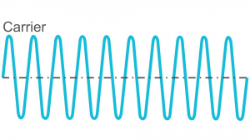
PEP & Average Readings
PEP is equal to average power if an AM carrier is not modulated
An unmodulated AM signal, a key down CW signal, and a FM signal are all constant power modes for which PEP = Average Power (“Ratio” = 1.00 )
Single sideband PEP is not equal to average power
If your CW transmitter generates 1060 W average output power, the PEP is also 1060 W

Slide 35
Take Quiz 2

Slide 36
G5B06 - What is the PEP produced by 200 volts peak-to-peak across a 50-ohm dummy load?
A. 1.4 watts
B. 100 watts
C. 353.5 watts
D. 400 watts

Slide 37
G5B06 - What is the PEP produced by 200 volts peak-to-peak across a 50-ohm dummy load?
A. 1.4 watts
B. 100 watts
C. 353.5 watts
D. 400 watts

Slide 38
G5B07 - What value of an AC signal produces the same power dissipation in a resistor as a DC voltage of the same value?
A. The peak-to-peak value
B. The peak value
C. The RMS value
D. The reciprocal of the RMS value

Slide 39
G5B07 - What value of an AC signal produces the same power dissipation in a resistor as a DC voltage of the same value?
A. The peak-to-peak value
B. The peak value
C. The RMS value
D. The reciprocal of the RMS value

Slide 40
G5B08 - What is the peak-to-peak voltage of a sine wave with an RMS voltage of 120 volts?
A. 84.8 volts
B. 169.7 volts
C. 240.0 volts
D. 339.4 volts

Slide 41
G5B08 - What is the peak-to-peak voltage of a sine wave with an RMS voltage of 120 volts?
A. 84.8 volts
B. 169.7 volts
C. 240.0 volts
D. 339.4 volts

Slide 42
G5B09 - What is the RMS voltage of a sine wave with a value of 17 volts peak?
A. 8.5 volts
B. 12 volts
C. 24 volts
D. 34 volts

Slide 43
G5B09 - What is the RMS voltage of a sine wave with a value of 17 volts peak?
A. 8.5 volts
B. 12 volts
C. 24 volts
D. 34 volts

Slide 44
G5B11 - What is the ratio of PEP to average power for an unmodulated carrier?
A. 0.707
B. 1.00
C. 1.414
D. 2.00

Slide 45
G5B11 - What is the ratio of PEP to average power for an unmodulated carrier?
A. 0.707
B. 1.00
C. 1.414
D. 2.00

Slide 46
G5B12 - What is the RMS voltage across a 50-ohm dummy load dissipating 1200 watts?
A. 173 volts
B. 245 volts
C. 346 volts
D. 692 volts

Slide 47
G5B12 - What is the RMS voltage across a 50-ohm dummy load dissipating 1200 watts?
A. 173 volts
B. 245 volts
C. 346 volts
D. 692 volts

Slide 48
G5B13 - What is the output PEP of an unmodulated carrier if the average power is 1060 watts?
A. 530 watts
B. 1060 watts
C. 1500 watts
D. 2120 watts

Slide 49
G5B13 - What is the output PEP of an unmodulated carrier if the average power is 1060 watts?
A. 530 watts
B. 1060 watts
C. 1500 watts
D. 2120 watts

Slide 50
G5B14 - What is the output PEP of 500 volts peak-to-peak across a 50-ohm load?
A. 8.75 watts
B. 625 watts
C. 2500 watts
D. 5000 watts

Slide 51
G5B14 - What is the output PEP of 500 volts peak-to-peak across a 50-ohm load?
A. 8.75 watts
B. 625 watts
C. 2500 watts
D. 5000 watts

Slide 52
General License Course Chapter 4.3 – Basic Components

Slide 53
Review - Prefixes
pico (AKA micro micro) = 1 trillionth = .000 000 000 001 = 10⁻¹²
nano = 1 billionth = .000 000 001 = 10⁻⁹
micro = 1 millionth = .000 001 = 10⁻⁶
milli = 1 thousandth = .001 = 10⁻³
1 = 1
kilo = x1,000 = 1000 = 10³
mega = x1,000,000 = 1,000,000 = 10⁶
giga = x1,000,000,000 = 1,000,000,000 = 10⁹

Slide 54
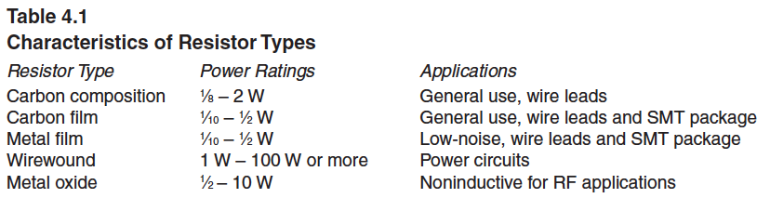
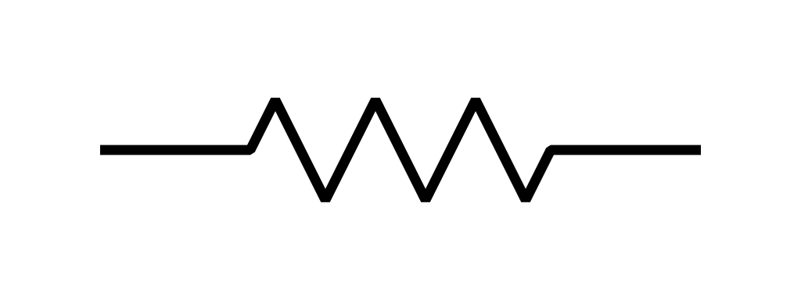
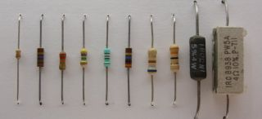
Resistors & Resistance
Resistors may have the same nominal value but vary in other characteristics

Slide 55
Resistors & Resistance
Resistance nominal values
1 Ω to more than 1 MΩ (value or color codes printed on them)
Standard values (no 500Ω - choose 470Ω or 510Ω)
Resistor Tolerance (accuracy)
Precision (1% or less), general purpose (5 or 10%)
Temperature Coefficients are resistance change characteristics (positive or negative)
Positive - resistance increases as temperature goes up
Negative - resistance decreases as temperature goes up
Thermistors - precise resistance changes in response to temperature

Slide 56
Resistors & Resistance
Parasitic Inductance: (inductance is the next topic)
Parasitic – unwanted characteristic resulting from the components physical construction (wire-wound resistor on a ceramic form)
Placing a wire-wound resistor in an RF circuit can disrupt operation or tuning (they are fine for DC or low frequency)
RF circuits normally use carbon composition, carbon film, or metal oxide resistors which have very low inductance

Slide 57
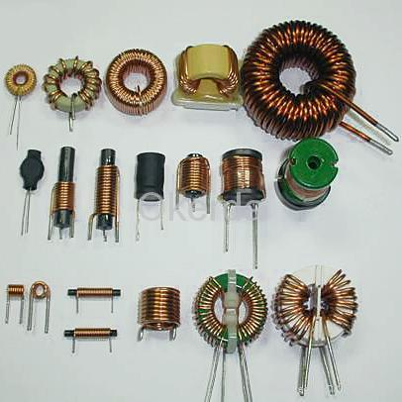
Inductors & Inductance
Inductors - sometimes also referred to as “chokes”
Inductance is the ability to store electromagnetic energy (measured in henries, H)
Increasing the core permeability will increase the ability to store magnetic energy and thus the inductance
The magnetic properties of the core (the “mix”) may be optimized for a specific range of frequencies

Slide 58
Inductors & Inductance
Variable inductors – used in low-power receiving and transmitting applications
Low-power - adjusted by moving a magnetic core in and out of the inductor
High-Power - adjusted by moving a sliding contact along the inductor, like a roller inductor in an antenna matching network

Slide 59
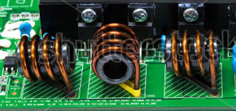
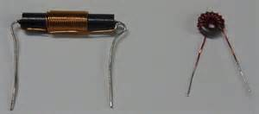
Inductors & Inductance
Toroidal inductors (with a magnetic core) keep nearly all of their magnetic energy in the core so that external coupling is minimized. Also, large values of inductance are attainable and the magnetic properties (“mix”) of the core can be optimized for a specific range of frequencies. ALL THREE!

Slide 60
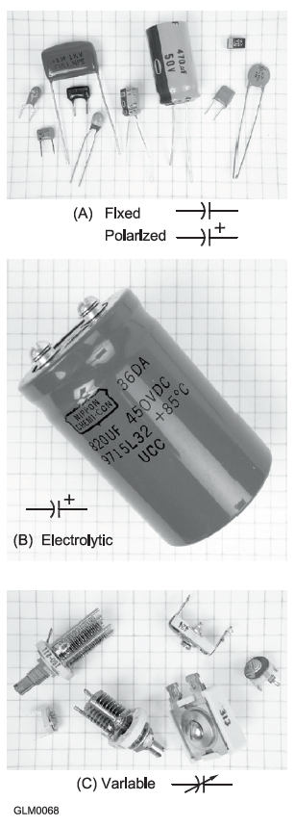
Capacitors & Capacitance
Capacitors (“caps”) have two conducting surfaces (electrodes) separated by a dielectric
Capacitance is the ability to store electrostatic energy, measured in farads, F
Blocks dc current flow

Slide 61
Capacitors & Capacitance
The simplest capacitor is a pair of metal plates separated by air
Capacitor types:
Ceramic – RF filtering, bypassing at high frequencies, low cost
Plastic film – audio circuits & lower radio frequencies
Silvered-mica – highly stable, low loss, use in RF circuits
Electrolytic and tantalum – power supply filter circuits
Air and vacuum dielectric – transmitting and RF circuits

Slide 62
Capacitors & Capacitance
Aluminum and tantalum electrolytic capacitors
Dielectric is a thin film
Voltage must be applied with the correct polarity; failure to do so can cause destruction of the dielectric layer leading to a short circuit and possible overheating/explosion (all three...)
Benefit – Create large capacitances in comparatively small volumes

Slide 63
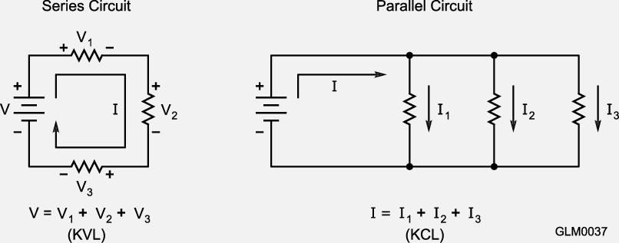
Components in Series & Parallel Circuits
Kirchhoff’s Voltage Law - Kirchhoff’s Current Law
Total current = the sum of the
currents in each branch

Slide 64
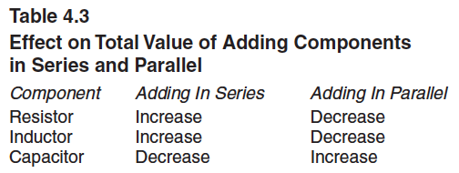
Adding Components in Series and Parallel

Slide 65
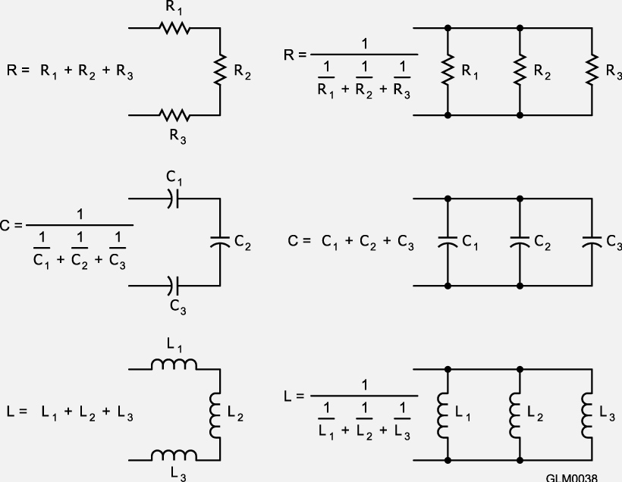
Doing the Math
...and learning some schematic symbols...

Slide 66
Doing the Math
Make your calculator do the hard work
Some calculators require a 2nd function key to get to a 2nd set of commands, like using the shift key on your computer keyboard
Example: A 100 and a 200 Ω resistor connected in parallel?
Keystrokes: 100 [function 1/x] + 200 [function 1/x] = 0.015 [function 1/x] =
66.666 Ω (round to 67 Ω)
Reciprocal of reciprocals...

Slide 67
Doing the Math
Three 100 μF capacitors in series?
Keystrokes: 100 [function 1/x] + 100 [function 1/x] + 100 [function 1/x] = 0.03 [function 1/x] = 33.33333 μF
Three 10 mH inductors in parallel?
Keystrokes: 10 [2nd function 1/x] + 10 [function 1/x] + 10 [function 1/x] = 0.3 [function 1/x] = 3.33333 mH
A 20 mH and 50 mH inductor in series?
Keystrokes: 20 + 50 = 70 mH (simple addition)

Slide 68
Doing the Math
A 20 μF and 50 μF capacitor in series?
Keystrokes: 20 [function 1/x] + 50 [function 1/x] = 0.07 [function 1/x] = 14.2857 μF (round to 14.3 μF)
A 10 Ω, 20 Ω, and 50 Ω resistor in parallel?
Keystrokes: 10 [function 1/x] + 20 [function 1/x] + 50 [function 1/x] = 0.17 [function 1/x] = 5.88235 Ω (round to 5.9 Ω)

Slide 69
Doing the Math
Units conversion practice: (μF = 10⁻⁶, nF = 10⁻⁹, pF = 10⁻¹²)
22,000 pF = 22 nF 4700 nF = 4.7 μF
What is the total capacitance of two 5 nF and one 750 pF in parallel?
(First convert 750 pF to nF = 750/1000 = 0.750 nF)
5 + 5 + 0.750 = 10.75 nF
What three equal value resistors wired in series will equal 450 Ω?
R x 3 = 450 Ω, divide both sides by 3 to put the R by itself. R = 450/3 = 150 Ω

Slide 70
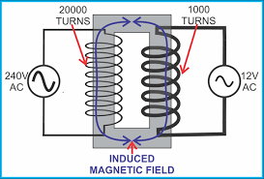
Transformers
Primary Winding – power is applied
Secondary winding – power is extracted
When AC voltage is applied to the primary winding (E_{P}), mutual inductance causes AC voltage (E_{S}) to appear across the secondary winding (works in both directions)
The turns ratio of the secondary (N_{S}) to the primary (N_{P}) windings determines how the current and voltage are changed
E_{S} = E_{P} × (N_{S} / N_{P}) and I_{S} = I_{P} × (N_{P} / N_{S})

Slide 71
Transformers
A significant change between primary and secondary voltage usually requires a change in the size of wire between windings
In a step-up transformer, the primary winding carries higher current and is wound with larger-diameter wire than the secondary
Mindful of the above, if you reverse the primary and secondary windings of a 4:1 step down transformer, it becomes a 4:1 step UP transformer.

Slide 72
Doing the Transformer Math
Example: What is the voltage across a 1500 turn secondary when 120 VAC is applied to a 500 turn primary?
E_{S} = (N_{S}/N_{P}) x E_{P}
Keystrokes:
E_{S} = 1500/500 = 3 x 120 = 360 V

Slide 73
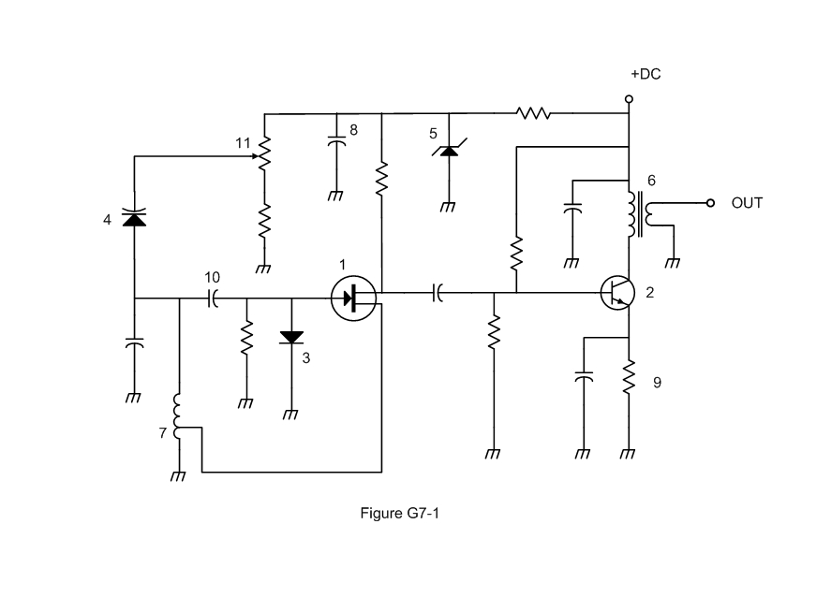

Schematic Symbols
Symbol 1 in figure G7-1 represents a field effect transistor
Maybe write these in on your handouts?

Slide 74
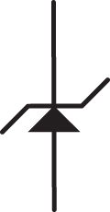
Schematic Symbols
Symbol 5 in figure G7-1 represents a Zener diode

Slide 75

Schematic Symbols
Symbol 2 in figure G7-1 represents an NPN junction transistor

Slide 76

Schematic Symbols
Symbol 6 in Figure G7-1 represents a solid core transformer

Slide 77

Schematic Symbols
Symbol 7 in Figure G7-1 represents a tapped inductor

Slide 78
Take Quiz 3

Slide 79
G7A09 - Which symbol in figure G7-1 represents a field effect transistor?
A. Symbol 2
B. Symbol 5
C. Symbol 1
D. Symbol 4

Slide 80

G7A09 - Which symbol in figure G7-1 represents a field effect transistor?
A. Symbol 2
B. Symbol 5
C. Symbol 1
D. Symbol 4

Slide 81
G7A10 - Which symbol in figure G7-1 represents a Zener diode?
A. Symbol 4
B. Symbol 1
C. Symbol 11
D. Symbol 5

Slide 82
G7A10 - Which symbol in figure G7-1 represents a Zener diode?
A. Symbol 4
B. Symbol 1
C. Symbol 11
D. Symbol 5

Slide 83
G7A11 - Which symbol in figure G7-1 represents an NPN junction transistor?
A. Symbol 1
B. Symbol 2
C. Symbol 7
D. Symbol 11

Slide 84
G7A11 - Which symbol in figure G7-1 represents an NPN junction transistor?
A. Symbol 1
B. Symbol 2
C. Symbol 7
D. Symbol 11

Slide 85
G7A12 - Which symbol in Figure G7-1 represents a solid core transformer?
A. Symbol 4
B. Symbol 7
C. Symbol 6
D. Symbol 1

Slide 86
G7A12 - Which symbol in Figure G7-1 represents a solid core transformer?
A. Symbol 4
B. Symbol 7
C. Symbol 6
D. Symbol 1

Slide 87
G7A13 - Which symbol in Figure G7-1 represents a tapped inductor?
A. Symbol 7
B. Symbol 11
C. Symbol 6
D. Symbol 1

Slide 88
G7A13 - Which symbol in Figure G7-1 represents a tapped inductor?
A. Symbol 7
B. Symbol 11
C. Symbol 6
D. Symbol 1

Slide 89
G6B01 - What determines the performance of a ferrite core at different frequencies?
A. Its conductivity
B. Its thickness
C. The composition, or "mix," of materials used
D. The ratio of outer diameter to inner diameter

Slide 90
G6B01 - What determines the performance of a ferrite core at different frequencies?
A. Its conductivity
B. Its thickness
C. The composition, or "mix," of materials used
D. The ratio of outer diameter to inner diameter

Slide 91
G6B05 - What is an advantage of using a ferrite core toroidal inductor?
A. Large values of inductance may be obtained
B. The magnetic properties of the core may be optimized for a specific range of frequencies
C. Most of the magnetic field is contained in the core
D. All these choices are correct

Slide 92
G6B05 - What is an advantage of using a ferrite core toroidal inductor?
A. Large values of inductance may be obtained
B. The magnetic properties of the core may be optimized for a specific range of frequencies
C. Most of the magnetic field is contained in the core
D. All these choices are correct

Slide 93
G6A04 - Which of the following is characteristic of an electrolytic capacitor?
A. Tight tolerance
B. Much less leakage than any other type
C. High capacitance for a given volume
D. Inexpensive RF capacitor

Slide 94
G6A04 - Which of the following is characteristic of an electrolytic capacitor?
A. Tight tolerance
B. Much less leakage than any other type
C. High capacitance for a given volume
D. Inexpensive RF capacitor

Slide 95
G6A08 - Which of the following is characteristic of low voltage ceramic capacitors?
A. Tight tolerance
B. High stability
C. High capacitance for given volume
D. Comparatively low cost

Slide 96
G6A08 - Which of the following is characteristic of low voltage ceramic capacitors?
A. Tight tolerance
B. High stability
C. High capacitance for given volume
D. Comparatively low cost

Slide 97
G5C01 - What causes a voltage to appear across the secondary winding of a transformer when an AC voltage source is connected across its primary winding?
A. Capacitive coupling
B. Displacement current coupling
C. Mutual inductance
D. Mutual capacitance

Slide 98
G5C01 - What causes a voltage to appear across the secondary winding of a transformer when an AC voltage source is connected across its primary winding?
A. Capacitive coupling
B. Displacement current coupling
C. Mutual inductance
D. Mutual capacitance

Slide 99
G5C02 - What is the output voltage if an input signal is applied to the secondary winding of a 4:1 voltage step-down transformer instead of the primary winding?
A. The input voltage is multiplied by 4
B. The input voltage is divided by 4
C. Additional resistance must be added in series with the primary to prevent overload
D. Additional resistance must be added in parallel with the secondary to prevent overload

Slide 100
G5C02 - What is the output voltage if an input signal is applied to the secondary winding of a 4:1 voltage step-down transformer instead of the primary winding?
A. The input voltage is multiplied by 4
B. The input voltage is divided by 4
C. Additional resistance must be added in series with the primary to prevent overload
D. Additional resistance must be added in parallel with the secondary to prevent overload

Slide 101
G5C05 - Why is the primary winding wire of a voltage step-up transformer usually a larger size than that of the secondary winding?
A. To improve the coupling between the primary and secondary
B. To accommodate the higher current of the primary
C. To prevent parasitic oscillations due to resistive losses in the primary
D. To ensure that the volume of the primary winding is equal to the volume of the secondary winding

Slide 102
G5C05 - Why is the primary winding wire of a voltage step-up transformer usually a larger size than that of the secondary winding?
A. To improve the coupling between the primary and secondary
B. To accommodate the higher current of the primary
C. To prevent parasitic oscillations due to resistive losses in the primary
D. To ensure that the volume of the primary winding is equal to the volume of the secondary winding

Slide 103
G5C06 - What is the voltage output of a transformer with a 500-turn primary and a 1500-turn secondary when 120 VAC is applied to the primary?
A. 360 volts
B. 120 volts
C. 40 volts
D. 25.5 volts

Slide 104
G5C06 - What is the voltage output of a transformer with a 500-turn primary and a 1500-turn secondary when 120 VAC is applied to the primary?
A. 360 volts
B. 120 volts
C. 40 volts
D. 25.5 volts

Slide 105
G5B02 - How does the total current relate to the individual currents in a circuit of parallel resistors?
A. It equals the average of the branch currents
B. It decreases as more parallel branches are added to the circuit
C. It equals the sum of the currents through each branch
D. It is the sum of the reciprocal of each individual voltage drop

Slide 106
G5B02 - How does the total current relate to the individual currents in a circuit of parallel resistors?
A. It equals the average of the branch currents
B. It decreases as more parallel branches are added to the circuit
C. It equals the sum of the currents through each branch
D. It is the sum of the reciprocal of each individual voltage drop

Slide 107
G5C03 - What is the total resistance of a 10-, a 20-, and a 50-ohm resistor connected in parallel?
A. 5.9 ohms
B. 0.17 ohms
C. 17 ohms
D. 80 ohms

Slide 108
G5C03 - What is the total resistance of a 10-, a 20-, and a 50-ohm resistor connected in parallel?
A. 5.9 ohms
B. 0.17 ohms
C. 17 ohms
D. 80 ohms

Slide 109
G5C04 - What is the approximate total resistance of a 100- and a 200-ohm resistor in parallel?
A. 300 ohms
B. 150 ohms
C. 75 ohms
D. 67 ohms

Slide 110
G5C04 - What is the approximate total resistance of a 100- and a 200-ohm resistor in parallel?
A. 300 ohms
B. 150 ohms
C. 75 ohms
D. 67 ohms

Slide 111
G5C08 - What is the equivalent capacitance of two 5.0-nanofarad capacitors and one 750-picofarad capacitor connected in parallel?
A. 576.9 nanofarads
B. 1,733 picofarads
C. 3,583 picofarads
D. 10.750 nanofarads

Slide 112
G5C08 - What is the equivalent capacitance of two 5.0-nanofarad capacitors and one 750-picofarad capacitor connected in parallel?
A. 576.9 nanofarads
B. 1,733 picofarads
C. 3,583 picofarads
D. 10.750 nanofarads

Slide 113
G5C09 - What is the capacitance of three 100-microfarad capacitors connected in series?
A. 0.33 microfarads
B. 3.0 microfarads
C. 33.3 microfarads
D. 300 microfarads

Slide 114
G5C09 - What is the capacitance of three 100-microfarad capacitors connected in series?
A. 0.33 microfarads
B. 3.0 microfarads
C. 33.3 microfarads
D. 300 microfarads

Slide 115
G5C10 - What is the inductance of three 10-millihenry inductors connected in parallel?
A. 0.30 henries
B. 3.3 henries
C. 3.3 millihenries
D. 30 millihenries

Slide 116
G5C10 - What is the inductance of three 10-millihenry inductors connected in parallel?
A. 0.30 henries
B. 3.3 henries
C. 3.3 millihenries
D. 30 millihenries

Slide 117
G5C11 - What is the inductance of a circuit with a 20-millihenry inductor connected in series with a 50-millihenry inductor?
A. 7 millihenries
B. 14.3 millihenries
C. 70 millihenries
D. 1,000 millihenries

Slide 118
G5C11 - What is the inductance of a circuit with a 20-millihenry inductor connected in series with a 50-millihenry inductor?
A. 7 millihenries
B. 14.3 millihenries
C. 70 millihenries
D. 1,000 millihenries

Slide 119
G5C12 - What is the capacitance of a 20-microfarad capacitor connected in series with a 50-microfarad capacitor?
A. 0.07 microfarads
B. 14.3 microfarads
C. 70 microfarads
D. 1,000 microfarads

Slide 120
G5C12 - What is the capacitance of a 20-microfarad capacitor connected in series with a 50-microfarad capacitor?
A. 0.07 microfarads
B. 14.3 microfarads
C. 70 microfarads
D. 1,000 microfarads

Slide 121
G5C13 - Which of the following components should be added to a capacitor to increase the capacitance?
A. An inductor in series
B. An inductor in parallel
C. A capacitor in parallel
D. A capacitor in series

Slide 122
G5C13 - Which of the following components should be added to a capacitor to increase the capacitance?
A. An inductor in series
B. An inductor in parallel
C. A capacitor in parallel
D. A capacitor in series

Slide 123
G5C14 - Which of the following components should be added to an inductor to increase the inductance?
A. A capacitor in series
B. A capacitor in parallel
C. An inductor in parallel
D. An inductor in series

Slide 124
G5C14 - Which of the following components should be added to an inductor to increase the inductance?
A. A capacitor in series
B. A capacitor in parallel
C. An inductor in parallel
D. An inductor in series

Slide 125
Next Week
Chapters 4.4 and 8

